Slide 1
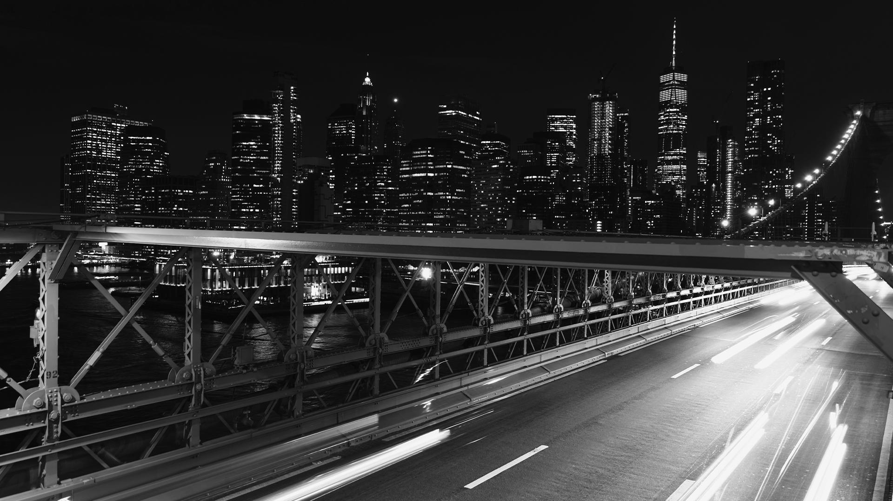
Market Research on Used Cars in Singapore
Done by: Error 404 [Group 4]

Slide 2
Problem Statement
You’ve have been hired by a startup that wishes to get into the used car market in Singapore. As such, you were tasked to conduct some market research on competitors and come up with business insights.

Slide 3
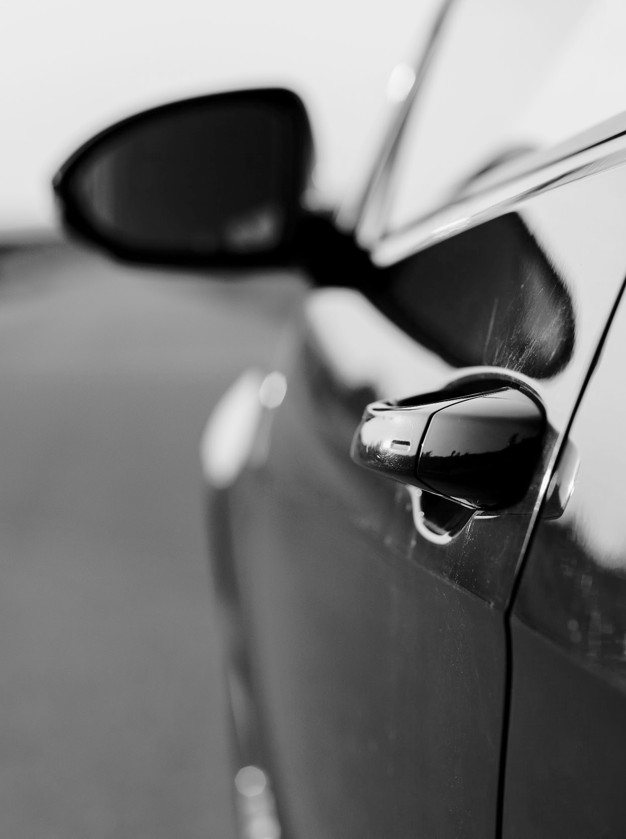

Approach
Web scraped sgCarMart (Singapore’s most popular car buying and selling website) with BeautifulSoup and get insights through the used car listings data!

Slide 4
Business Insights

Slide 5

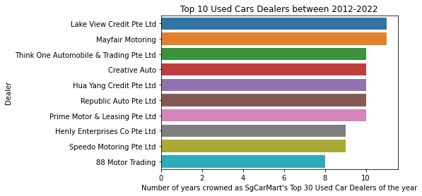
Top 10 Used Car Dealers
sgCarMart has been crowning top 30 used car dealers annually as premium dealers since 2012
Barplot shows the top 10 dealers with the highest frequency counts of making it to top 30 of the year
A good starting point for us to target some of these trusted and established car dealerships
Notes:
As a start-up, it may be more feasible to go after smaller car dealerships. While this should still be done, there is no harm in trying to get some of the more popular and established ones onboard our platform too - even one would make our site more “legit”. Furthermore, there is as many as around 500 used car dealers in Singapore or even more, so it would make sense to put more effort into securing some of the top players in the industry which have been narrowed down by the trusted and most popular automotive e-commerce platform (sgCarMart). As a new startup, we first need to drive traffic to our platform. To do this, we first need to earn the trust of clients and give them a good service so that they can recommend our platform to others. As such, it is important that we get trusted dealerships so that we can ensure that good service is being given to our customers. These trusted dealerships might also have the incentive to switch over to our platform as even on sgcarmart, they are competing with other trusted brands, making the platform saturated with dealerships and preventing the dealerships from being able to increase their sales. On our new platform, they will be a part of a smaller market of dealerships, allowing their postings to get more exposure and visibility of their listings and allow them to increase their sales.

Slide 6
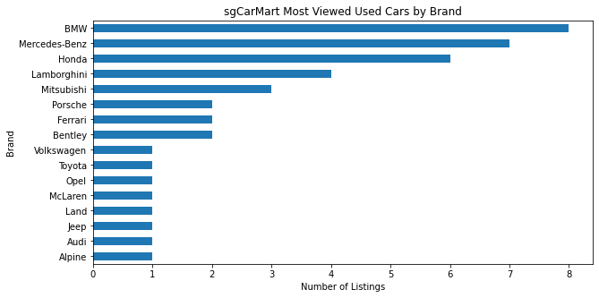
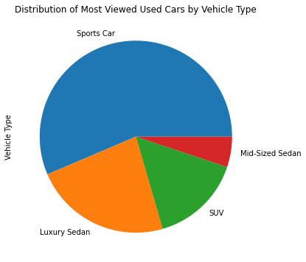
sgCarMart Most Viewed Used Cars
Suggests people generally like to view fancy cars - particularly Sports Cars & Luxury Sedans
Not necessarily looking to buy
But may be good to have dealers carrying some of these brands to attract consumers to our site -> gain exposure -> consumers likely to continue exploring site for other listings
Notes:
Most of the most viewed cars on sgCarMart are fancier, more expensive cars -> suggests that people generally like to view such cars
Although this does not necessarily mean that they want to buy these cars
But could be a good idea to have dealers that carry such brands so that when consumers search for these cars, our site will still be returned as one of the search results -> gain exposure
In the beginning, fewer customers would know our website, so few of them would search for listings directly on our website. Most of them would probably come on to our website after searching for listing on a search engine like google. This might be because some customers might want to compare prices among different platform other than sgcarmart to get the best deal. As such, it would be beneficial for us to have types of cars which are viewed often on our platform so that we can turn up higher on a greater number of searches and get more exposure to more potential customers. (Basically SEO)
And if the consumer happens to click on our website link to view a listing, they are likely to continue exploring the site to view other listings too

Slide 7
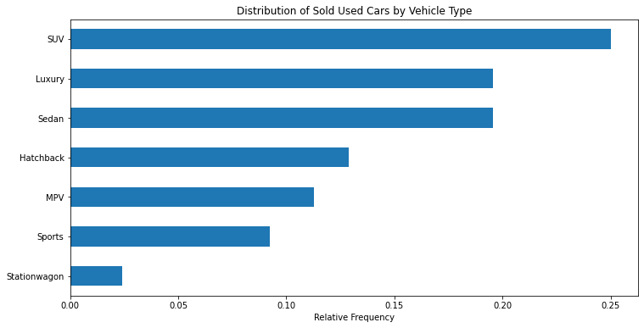
Distribution of Sold Used Cars by Vehicle Type
SUV and Luxury Sedans are also popular cars based on sold car listings, consistent with previous finding based on most viewed cars by brand
Notes:
Link back to previous slide (on most viewed used cars by vehicle type)
Conclude that we should try to ensure that there are more SUV and Luxury Sedans cars listings
Sports car was the most popular in terms of listing view count; in terms of sales it may not be doing as well as SUV and Luxury Sedans, but it still makes up for around 10% of the sold used cars so it is still worthwhile to seek sports car listings -> to attract website visitors who may very well go through with purchasing a sports car / at least have them explore other listings. The used sports car market could be a gap in the current market that our startup could exploit. This is because, as seen in the previous slide, sports cars are the most viewed cars on the sgcarmart platform, showing that there is great interest in the sector. Our startup could find ways to capitalise on this interest so that we can get more traffic to our platform.

Slide 8
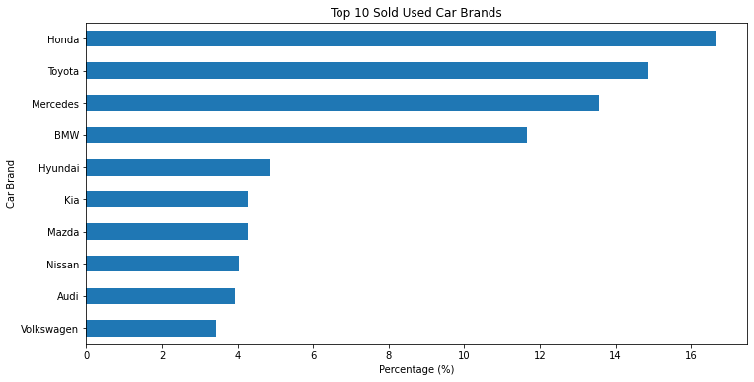
Top 10 Sold Used Car Brands
Provides a general idea on what car brands are popular in Singapore
Target dealers with these specific car brands
Notes:
Here is another bar plot showcasing the top 10 sold used car brands in Singapore. From this chart, we can tell that close to 17% of the sold used cars are Honda and around 15% are Toyota. As a startup, you will want to earn as much commission from the car dealership and one way to do this is to target car brands which are more popular in Singapore, so that there is higher demand from the public and this will lead to higher sales. Startup usually do not have enough resources to partner with so many car dealership, hence they can start by targeting dealers with these specific car brands.

Slide 9
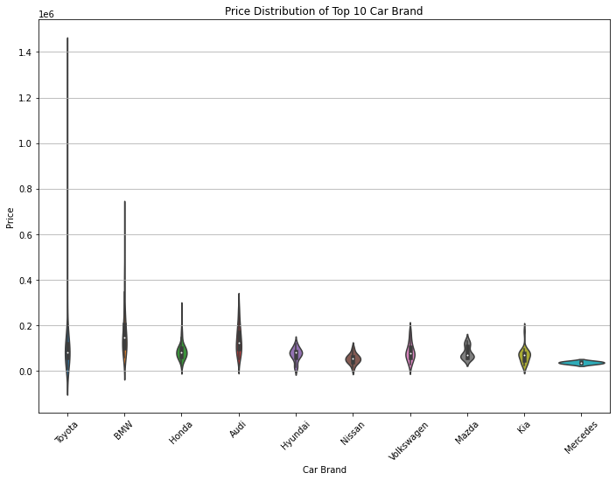
Price Distribution of Top 10 Car Brands
Majority of cars under the top 10 car brands are generally priced around $80,000 to $100,000.
BMW and Toyota have much larger price range
Notes:
Link to prev slide [Top 10 Sold Used Car Brands]
We then looked further into the price distribution of these top 10 car brands (as mentioned in prev slide).
The median price of used cars for brands like Toyota, Honda, Hyundai, Volkswagen, Mazda and Kia is relatively similar at around $80,000 to $100,000. Toyota and BMW has much larger price range, for example the most expensive Toyota car sold is around $1.4 million and for BMW, is around $700,000. Another interesting insight is that Mazda has a bimodal distribution while the rest of the brands are unimodal. We can also tell that in general, BMW and Audi is more expensive than other car brands as their 75 percentile is around $200,000. With these data, the startup can get a clearer idea on the price distribution of different car models and maybe use it to target customers with different levels of budget.

Slide 10
Thank you!

